Slide 1
DAYCARE and preschool IN MY COMMUNITY
DANSOMAN-ABLEKUMA WEST

Slide 2
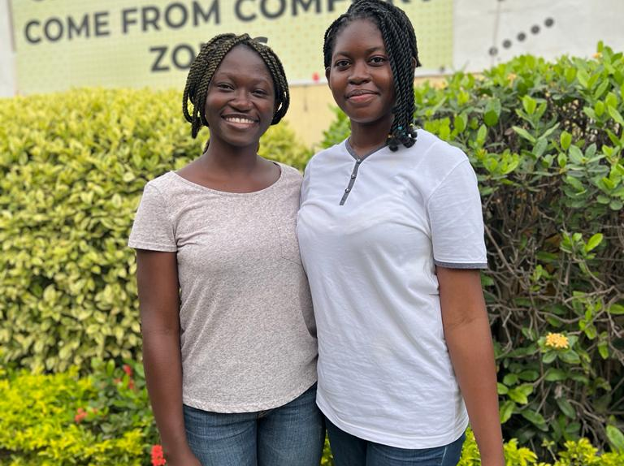
Founders
1. Abigail Sarpong Afriyie
2.Day Ewuresi Efriye Yawson

Slide 3
overview
-Discovery was made on daycare having problems to show their existence in the locality.
-Parents having to trust their wards with these institution and people.
??Map/Location
??Platform for both parents and institutions
??Update and Reviews

Slide 4
OVERVIEW CONT.
??Regulations
??Reviews
??Grade of the schools due to their facilities, staff, and location.
??Rating daycare/preschool
??N.G.O
-Giving information on how to open new daycares/pre-schools for new customers.

Slide 5
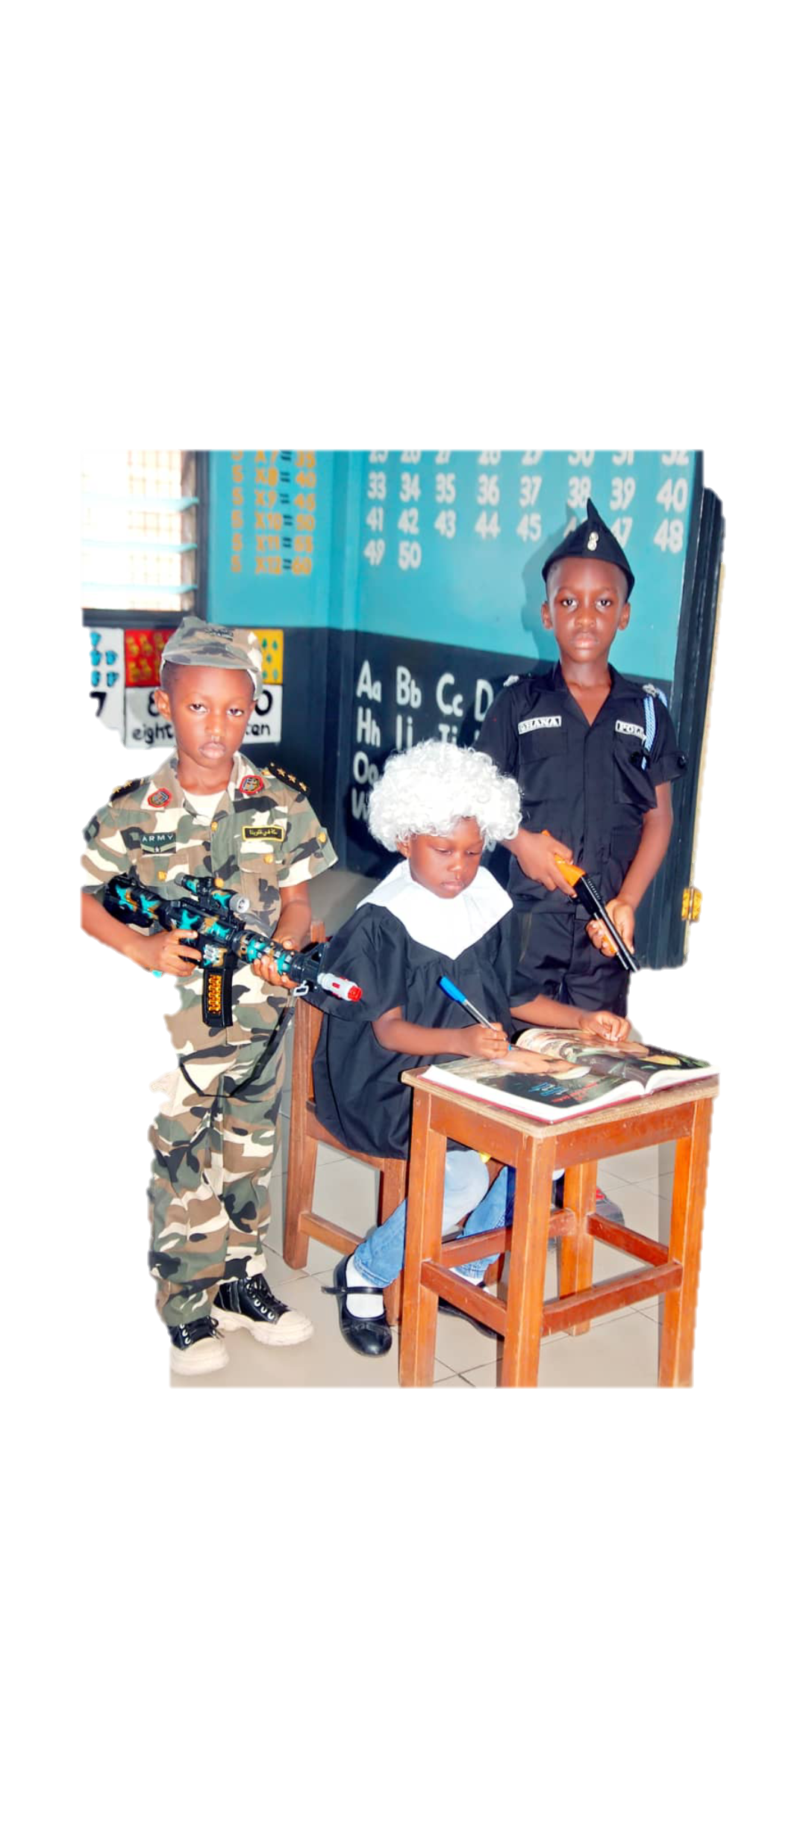
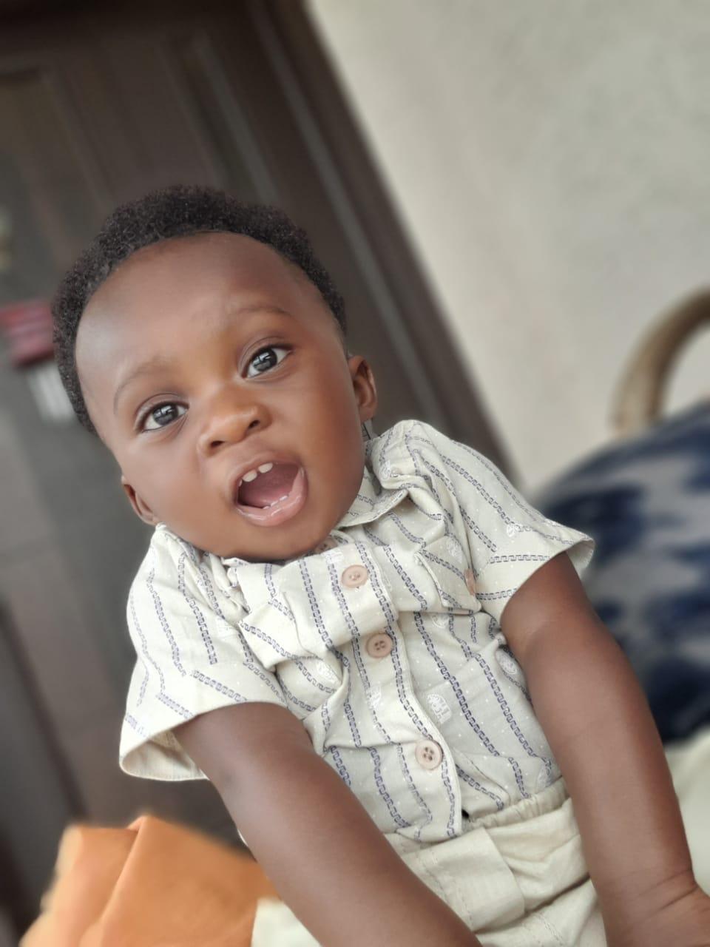
Target age
0 yrs-2 yrs
3 yrs-5 yrs

Slide 6
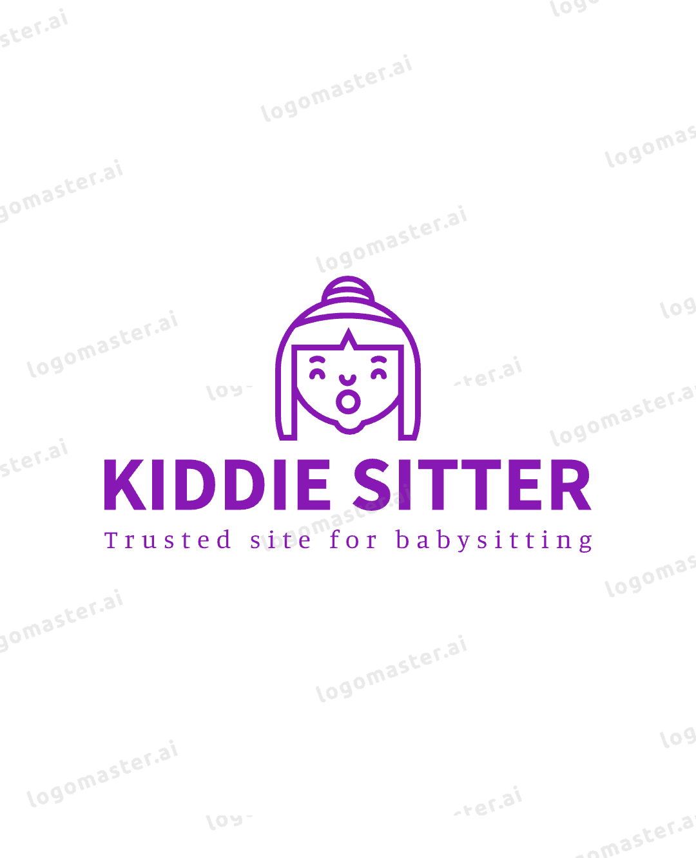
???Name of website???
Kiddie sitter

Slide 7
purpose
What brought about our idea??
Parents nowadays are both busy with their works, therefore after maternity leave ,they need a trusted person or institute to take care of their kids when they are at work.
DANSOMAN is known for having a lot of people settling. i.e.; couples beginning to start their families.
Due to the expansion of businesses and building in my community, Dansoman. A lot people are settling here and our population keeps increasing .
-What we discovered in the community was parents finding difficulty in getting daycares and preschool for their wards.

Slide 8
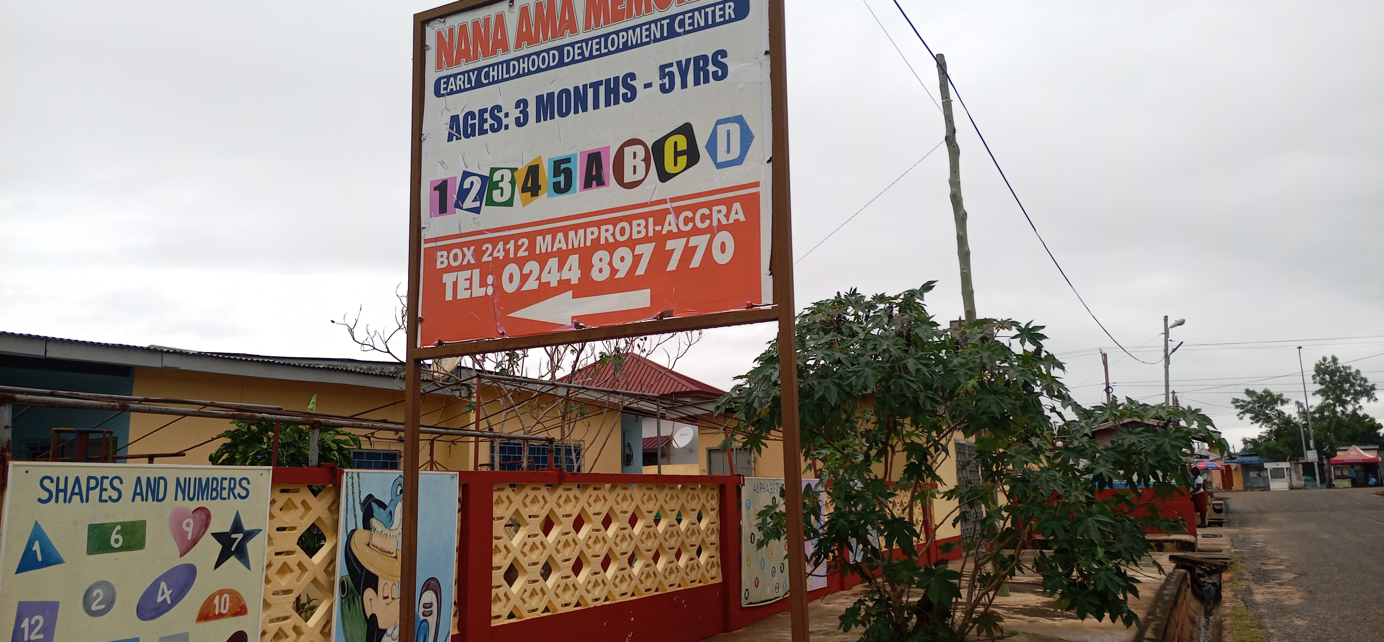
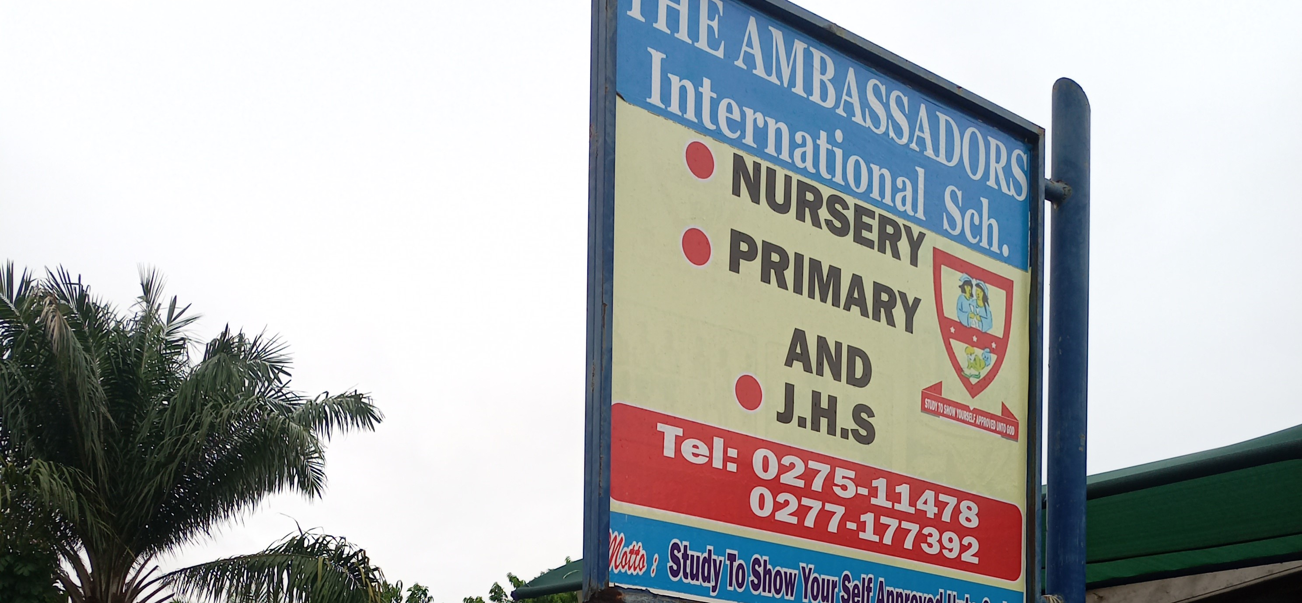
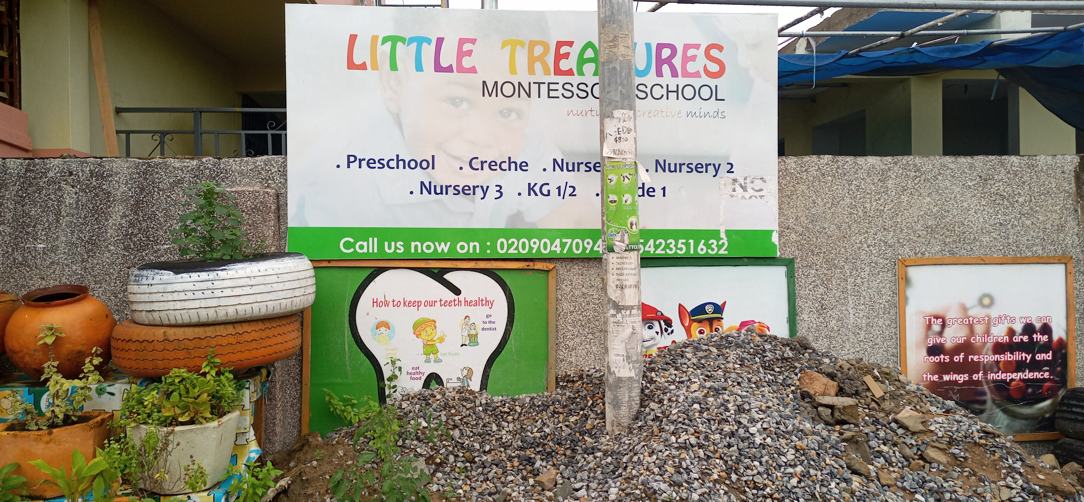
Some daycare/preschool in dansoman
Nana Ama, Montessori,school
The Ambassadors Int. sch.
Little Treasures Montessori
Age range 3 months-5 years
Age range : 2 years-5 years
location:23 mahogany close, Dansoman
Age range :2 years-5 years

Slide 9
Application scenarios
-A website to allow viewers (parents and daycare/pre-school) to interact and share their issues.
-A website that help daycares/pre-school to improve just by getting update and feedbacks from the public.
-A website accessible to the public in general, and daycare and pre-school on monetary condition.
-A website with all daycare and preschool location in the locality(that is; all those who sign up).
-A website with regulations and information for new daycares and preschools.
-A website for which N.G.O (locally and international) can contact to donate and fund both monetary/kids play toys/books/furniture.

Slide 10
problems
Availability: few daycares and preschools in the community.
Accessibility: difficulty in locating daycares And preschools.
Distance problem :that is dropping their kids at daycares and preschools faraway.
Lack of knowledge about regulations in daycares: people do not know there are rules governing daycares and preschools in Ghana.
Safety and precaution issues in daycare and preschools are not brought up and not tackled on by officials responsible.
Lack of information about some daycare and preschools are not available to parents looking for choices to make on the daycare or preschool their wards should attend.

Slide 11
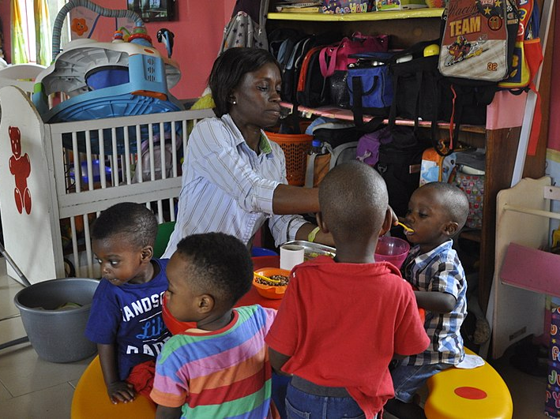
Daycare and Preschool solutions
Making daycare and preschool accessible, available and information should easily found when search for on the net.
Since everything is now made available on the net ,such information should be made accessible and available at such platform.

Slide 12
competitors
Most of our competitors are not in Ghana .
-winnie-
-sittercity-
-momni-
-the motherlode-
-care.com-

Slide 13
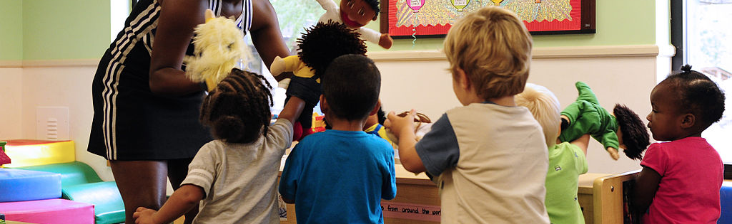
Conclusion
Child care can consist of advanced learning environments that include early childhood education or elementary education. "The objective of the program of daily activities should be to foster incremental developmental progress in a healthy and safe environment and should be flexible to capture the interests of the children and the individual abilities of the children."

Slide 14
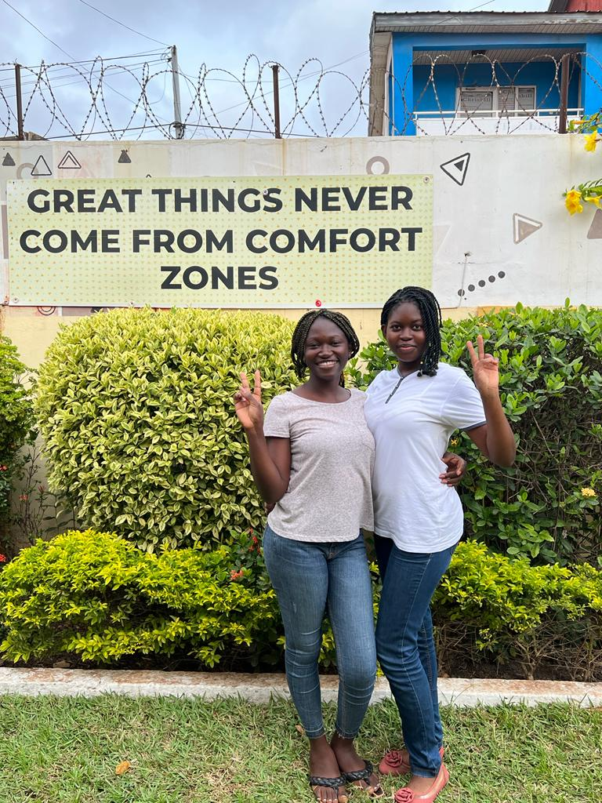
THANK YOU!!

